Slide 1
Jap2JETTY MIGRATION
Presented By
Uttam Bhatia

Slide 2
Why the migration?
To remove the dependency of heavy resource intensive JAP server & make it serverless application.
Keep in pace with rapidly changing
Adaption to open source features.
technologies.
Cloud enabled
Microservices.

Slide 3
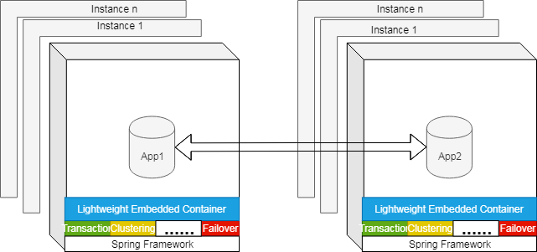
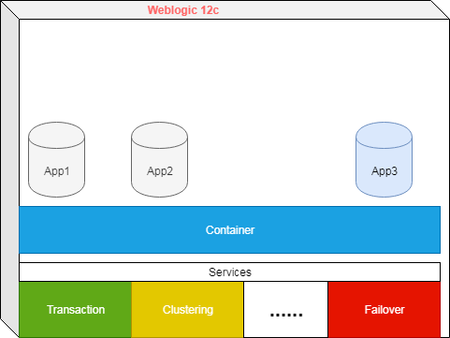
New vs Old Architecture
Embedded Jetty Server
JAP Server

Slide 4
Introduced Spring boot 2.x - Paradigm shift
Advantages
Opinionated Defaults Configuration
Provides embedded runtime support i.e. jetty, tomcat etc
Absolutely no code generation and no requirement for XML configuration
Provide production-ready features such as metrics, health checks and externalized configuration
Developer productivity tools such as LiveReload and Auto Restart

Slide 5
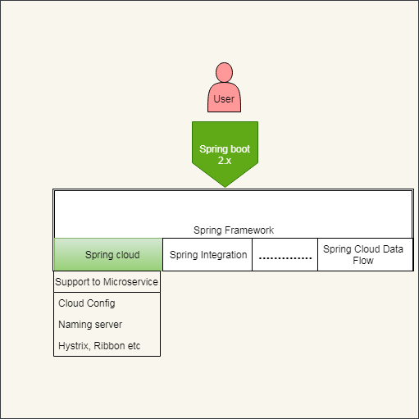
Spring boot 2.x continued
Support to evolving features

Slide 6
PoC

Slide 7
PoC Features Implementations
Spring boot 2.x
JAXWS Spring Integration
Maintain WSDL Similarity
Embedded Runtime environment setup i.e. Jetty
Running service with SSL Certificate
DB JNDI Configuration in embedded jetty server.
Build-time Profiling

Slide 8
PoC Features Implementations…
Configuration Management – Externalize configuration
Application Logging

